Slide 1
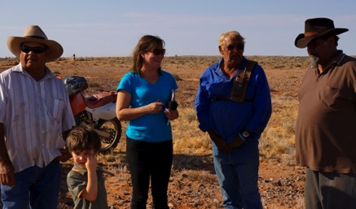
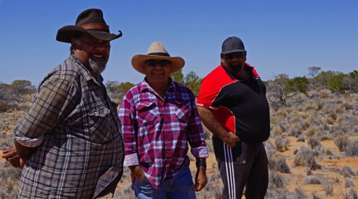
The Arabana and Water Governance: Landcare and Caring for Country
Melissa Nursey-Bray
Landcare Conference, Waikerie
University of Adelaide
2015
Notes:
Managing our water resources is one of the pressing governance issues of our time. This paper presents the results of a case study of Indigenous water governance in Australia: the Arabana people of the Kath-Thanda Lake Eyre. The paper explores the key features of and challenges created by the juxtaposition of Indigenous and Western governance regimes in this context. The Kati-Thanda – Lake Eyre region is subject to multi jurisdictional NRM arrangements, yet Arabana people are more closely concerned with caring for their country within it. Our project concerned the development of cultural indicators for water by the Arabana people, and examined the juxtaposition of the two modes of environmental management implicit in their establishment. The use of cultural indicators has two advantages – it enables finer scale and local data to be collected about ecosystems, but also provides avenues for active involvement of and recognition of Indigenous participation and working knowledge in environmental governance. I argue that the collaborative development of cultural indicators as modes of assessing condition, when linked to Indigenous value and knowledge systems can build transdisciplinary bridges between Western (aka Landcare) and Indigenous (caring for country) governance regimes, and provide a more holistic means to create positive management outcomes for people and country. This is not the same as trying to achieve integration between different governance regimes, but lights a pathway by which policy makers and end users can build connections between them, to achieve better outcomes for all.

Slide 2
Setting Context
Overarching project: To develop a set of indicators to assess the environmental condition of the aquatic ecosystems of the Lake Eyre Basin (LEB)
Integration and analysis of existing and new ecological and spatial datasets to develop quantitative indicators of environmental condition (to monitor and assess and monitoring the condition of the LEB at various scales).
New datasets will include:
flood inundation and other hydrological information
population dynamics of aquatic biota (fish)
aboriginal perceptions and values
nutrient status

Slide 4
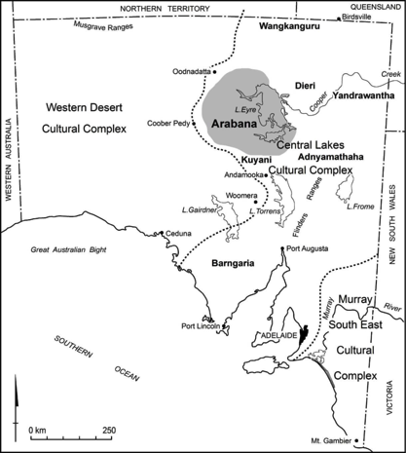
The Arabana
Notes:
As a region, Kati Thanda - Lake Eyre is unique. It is Australia's largest salt lake, located 647 km north east of Adelaide in the state of South Australia and its catchment spans Queensland, the Northern Territory, South Australia, and New South Wales. It is a drainage basin of over 1.2 million square kilometres and at 15.2 metres below sea level in its eastern perimeter, is Australia’s lowest point. The Basin consists of two lakes: Lake Eyre North and Lake Eyre South both of which are connected by the Goyder Channel (Arid Lands NRM 2010). The region experiences little rain, and floods on average only four times a century; although between 2006 and 2011 there have been many more rain events than usual. Named after the English explorer Edward John Eyre, the region is also the traditional land for the Arabana, the Anangu Pitjantjatjara Yankunytjatjata (APY) Lands, and other Indigenous peoples who have inhabited the area for thousands of years. Today, there are about 57,000 people living in the basin working in pastoralism, tourism, mining and petroleum; as well as township based work such as retail, education, medical and other services.
The Arabana people are an Indigenous group located within the Kati Thanda- Lake Eyre region: Arabana people also due to colonisation have been dispersed across the entire continent, and live in Darwin, through to Adelaide respectively (see map 1 for details). Political leadership of the Arabana is vested within the Arabana Board of Directors, most of whom live in Port Augusta, yet there are important loci of traditional leadership (based in Alice Springs) and social leadership (Darwin) which contribute to the contemporary Arabana identity.

Slide 5
How did we do it?
Arabana Researcher
Meetings
On country field trip
Identification of values and indicators
Photo voice activities
Literature review
On country field trip
Indicators Workshop
Integration Workshop
Reporting

Slide 6
Results
Water values
Water Types
Water Indicators

Slide 7
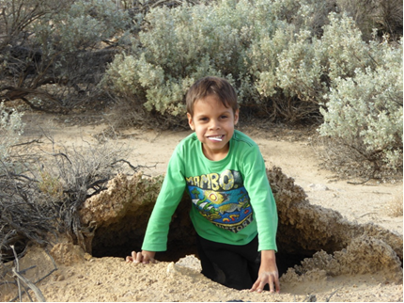
Water Values
“Water is our life, need to think about keeping it, looking after it, the waterholes is where we all met back in the day, where the uncles went camping, hunting, we used them to wash in, swim in sometimes, now all over, its drying up…we need to find ways of keeping water in country” (Arabana respondent 2, 2015).
Survival
Access site knowledge
History
Identity
Resilience
Variability and Change

Slide 8
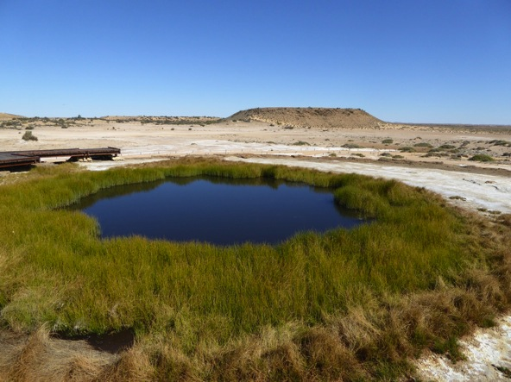
Mounds Springs
Notes:
"For a long time the hunter dug, hunting the stranger snake. Didna bagana, long creek beds are the digging paths of the hunter. He found the tunnel and at last the snake. He pulled it from the ground and killed it. Bithalina - the snake's writhings are the water movements in this spring (The Bubbler). The hunter prepared a large ground oven to prepare the snake. Dirga - the overn (Blanche Cup). After breaking it up to eat the hunter throw the snake's head away. Wabma-gadayabu - The Snakes Head (Hamilton Hill)" (DEWNR Interpretive Site Wabma - Gadayabu 2015)

Slide 9
Catchments
Notes:
Water is also referred to as ’catchments’. Initially this terminology may confuse Western scientists, but in fact for the Arabana means water that is literally ‘caught’ in soil indentations, and pool in those areas. There may thus be thousands of little catchments in the region after a rain. During the first field trip there were not many of these catchments, but during the second, due to a recent rainfall, there were many such small catchments.

Slide 10
Springs and waterholes

Slide 11
Constructed water sites

Slide 12
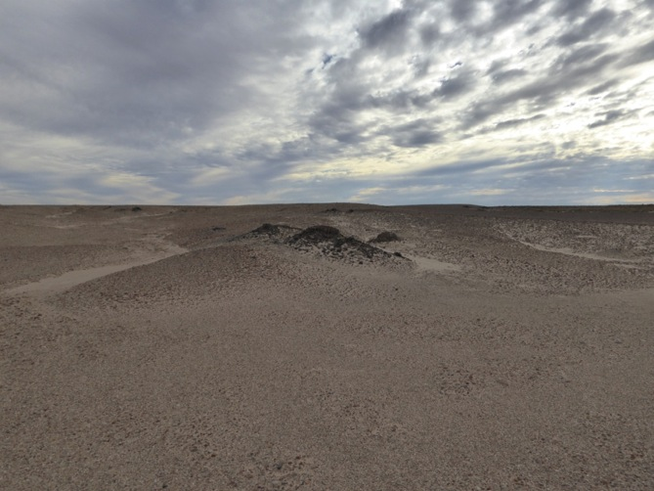
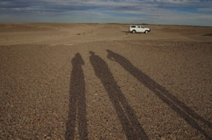
Part of how Arabana understand water is by its absence. In contemporary terms, this means that there are many sites that are understood as ‘water’ sites, but which at present have no water in them. There are two types of ‘absent’ sites – firstly, there are sites where living memory charts a change in water flow: ”when I was growing up this used to flow over and gush down like waterfall, no more now…” (Marree respondent 1 2015). The absence of water in these cases is usually attributed to current impacts such as mining, or due to seasonal or climate variability. The other type of ‘absent’ water sites are those regions which are culturally significant, but which are water sites from millennia past. For example, we were taken to ‘waterless’ sites which were areas that had numerous shell fossils and other fossils reflecting pre-existence of a marine environment and also cultural artefacts such as grinding stones, also indicating long dure’ Arabana existence. Hence, current important water sites for the Arabana also comprise areas where water was, but is no longer, both in living and traditional memory. Absent water
Notes:
Part of how Arabana understand water is by its absence. In contemporary terms, this means that there are many sites that are understood as ‘water’ sites, but which at present have no water in them. There are two types of ‘absent’ sites – firstly, there are sites where living memory charts a change in water flow: ”when I was growing up this used to flow over and gush down like waterfall, no more now…” (Marree respondent 1 2015). The absence of water in these cases is usually attributed to current impacts such as mining, or due to seasonal or climate variability. The other type of ‘absent’ water sites are those regions which are culturally significant, but which are water sites from millennia past. For example, we were taken to ‘waterless’ sites which were areas that had numerous shell fossils and other fossils reflecting pre-existence of a marine environment and also cultural artefacts such as grinding stones, also indicating long dure’ Arabana existence. Hence, current important water sites for the Arabana also comprise areas where water was, but is no longer, both in living and traditional memory.
Part of how Arabana understand water is by its absence. In contemporary terms, this means that there are many sites that are understood as ‘water’ sites, but which at present have no water in them. There are two types of ‘absent’ sites – firstly, there are sites where living memory charts a change in water flow: ”when I was growing up this used to flow over and gush down like waterfall, no more now…” (Marree respondent 1 2015). The absence of water in these cases is usually attributed to current impacts such as mining, or due to seasonal or climate variability. The other type of ‘absent’ water sites are those regions which are culturally significant, but which are water sites from millennia past. For example, we were taken to ‘waterless’ sites which were areas that had numerous shell fossils and other fossils reflecting pre-existence of a marine environment and also cultural artefacts such as grinding stones, also indicating long dure’ Arabana existence. Hence, current important water sites for the Arabana also comprise areas where water was, but is no longer, both in living and traditional memory.

Slide 13
The ‘signs’ – water indicators
Notes:
Water itself is an indicator for the Arabana. Given its variability, it is always of intense interest to Arabana as to how much has been present, and when the site in question had most recently experienced a rainfall event. The practice of observing how recent a water event had been was common practice every time we visited a site, and speaks to the importance of understanding varaiblity in this region; the extent of time in between ‘drinks’ also told the Arabana what to expect in relation to species composition, number and presence.
Arabana people charted the presence of water via: the colour of it; the staining of the soil; and where the colour and extent of ‘wetness’ could reveal how long ago and what amount of water had been present. The amount of water present was very important. Arabana people used comparison of site state from the last time they had seen it as a marker to understand its current health and continually reflected on the difference between the state of sites over time, rather than between physically comparative but geographically differentiated sites.
The colour of water was also an important part of interpreting the site. At one site the colour of the water was referred to as “the colour of a lovely cup of tea but without milk”. Water would be characterised according to its clarity or murkiness, and its colour, ranging from light blue to deep red. These signs also told the Arabana people about the condition and quality of the water. Levels of salinity were also used as an indicator, and were tested by taste, and also by observing the colour of the soil adjacent to the sites (i.e. white crust).

Slide 14
Questions?

Slide 15
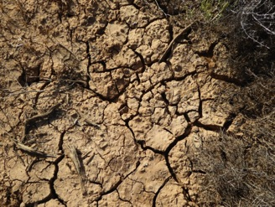
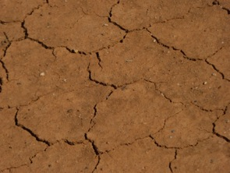
Soil Indicators
Notes:
The colour, condition, type and saturation of soil, as well as evidence of salinity and the extent of erosion are all further ways that Arabana people will read the signs of a site. For example, the presence of soakages, and whether or not they had water in them was signalled by the various size and shape of cracking in different soils. Wide cracking patterns with large cracks indicated drier sites than other smaller closer patterns.
Different soil colours tell Arabana people about the extent to which water had been absorbed and importantly how deep they might have to dig to access that resource. Deeper coloured stains indicated water was just below the surface and a lighter shade meant that some extra digging was required. Again, ‘absence’ of this indicator showed where a soakage or site had been a good water site and was no more. On a few occasions, Arabana people went to a site and found it had ‘dried-up’.
Erosion was interpreted in many river water sites as being a positive sign/indicator. Where erosion was manifest and recent, this meant that water had been recently present. On the other-hand, where there was evidence of erosion in floodway sites, this was of concern as it may have implications for cultural site management. There is one site, traditionally a men’s ceremony site, that was of particular concern where Arabana people, by observing the extent of erosion, could assess the level of damage to this area.

Slide 16
Historical Indicators

Slide 17
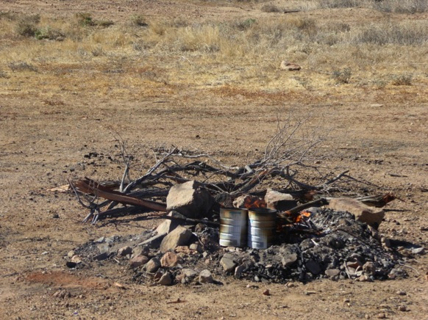
Useability Indicators
Notes:
When visiting water sites, it emerged that an important dimension of their relative health for the Arabana relates to its ‘useability’. Arabana country is located in the arid desert and thus water’s main characteristic or value is in its capacity to be used. In this sense, Arabana people assess whether the site has ‘drinkability’, in terms of 'hydrating stock', or 'washing' . Taste is often used to determine levels of salinity, and useability.
Arabana also assess a water site as to its capacity to be used for camping, ceremony or family visits. Devonport Springs, Finniss Springs, Kurdimurka are all examples of very important sites. Historical knowledge is very important for this indicator and is assessed based on past use such as for the building of the old Ghan railway, for pastoralism or mining? Arabana people would often relay stories of their employment on the Ghan Railway or of experience working in Anna Creek or other pastoral station across the region and the ways in which the water sites were used. The past or present use of the site in this sense will also inform Arabana assessment of a site.

Slide 18
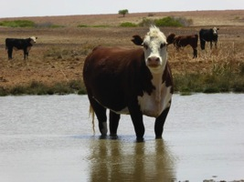
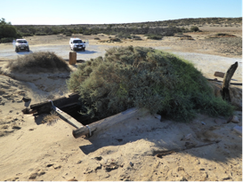
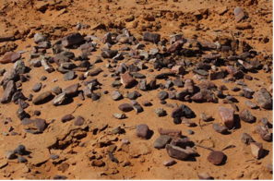
Pressure Indicators
“I think I am pretty certain the mining has affected our water – it was fine before, springs running and flowing all over the place, nowadays there is nothing and the pressure has gone as well – bubble another one we used to in the past we used to bubble so huge, the noise you could hear it from coward springs, where is that water?" (William Creek respondent).
Notes:
extent to which that condition is a result of external pressures, characterised here as ‘pressure’ indicators. Identified pressures included climate change, mining, loss of traditional knowledge via loss of elders or people moving away from country and pastoralism.
When visiting sites, Arabana people reflect on how these pressures were visible to them as indicators of condition. For example, at some sites, Arabana people could see the signs of recent cattle movements. In one culturally important site, Arabana people discussed their concern that increasing and more intense flood waters, resulting from climate change would flood important men’s sites and wash them away.
Time and again, mining was cited as a causal factor in the ongoing drying-up of streams and water holes:
“I think I am pretty certain the mining has affected our water – it was fine before, springs running and flowing all over the place, nowadays there is nothing and the pressure has gone as well – bubble another one we used to in the past we used to bubble so huge, the noise you could hear it from coward springs, where is that water?" (William Creek respondent).
Knowledge about the sites is also under threat as a result of Elders dying or being sick. Given there are only now a few Arabana individuals who can speak the language, and that many people now live away from these sites, ensuring ongoing stewardship of them, and maintenance of cultural knowledge is a valid and ongoing pressure indicator. Finally, as demonstrated in previous work on climate change adaptation (Nursey-Bray et al. 2015), the Arabana people are very worried about and have observed significant changes to the climate over time.
These pressures provide contemporary platforms by which Arabana seek to understand and explain what is happening to their water sites today that threaten the values they hold for them. Every time Arabana people visit water sites, they observe these pressures. By applying these facets as indicators, Arabana people chart change in these systems over time, as well as identify or attribute their causes.

Slide 19
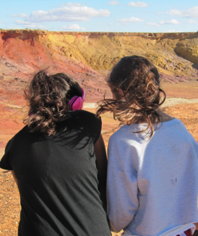
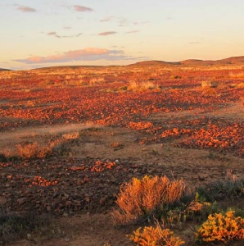
Caring for Country to Landcare
Opportunities for integration?
Opportunities for co-existence?

Slide 20
The use of cultural indicators…
…has the following advantages
it enables finer scale and local data to be collected about ecosystems’
it provides avenues for active involvement of and recognition of Indigenous participation and working knowledge in environmental governance.
Builds bridges to integrate knowledge systems and environmental practice

Slide 21
Characteristics of Scientific Indicators | Characteristics of Cultural Indicators
Robust and objective | Qualitative and subjective
Uses methods and equipment that are well tested and reviewed. | Cultural methods rely on collective skills/knowledge held by cultural group
Requires a high degree of professional expertise and experience | Based to a high degree on acquiring in-depth knowledge of a local environment
Measures precise changes to river and stream health over time | Require a high degree of consistency in the assessment in order to measure and detect long-term changes to an environment.
Relatively costly | Cost effective
Often over wider whole catchments | Often very site specific
Top down | Bottom up

Slide 22
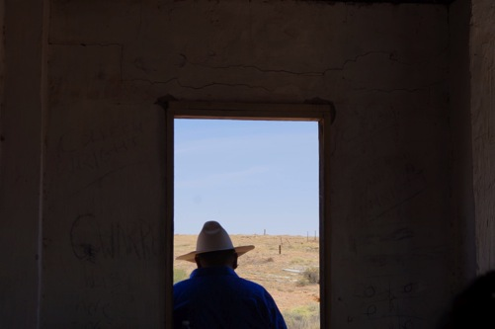
“water planning processes must contain the possibility of an explicit approach to mutual recognition and consequent translation of the conceptual and pragmatic bases of water management and planning in both Western and Indigenous domains” (Ayre and MacKenzie 2013, 753).
Notes:
Indigenous peoples are the harbingers, and custodians of that knowledge and country, and are often best placed to actively manage it over time; not just for cultural but also ecological values. Indigenous people's are most often living in or visiting those regions, and hence may also play an active role, once trained, in undertaking assessments for cultural and ecological condition.

Slide 23
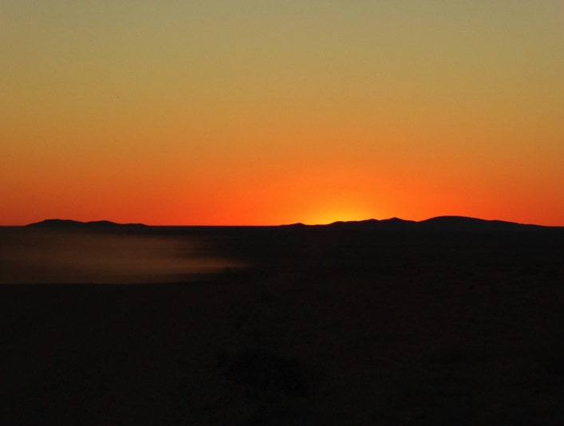
Questions?
Email: Melissa.Nursey-Bray@adelaide.edu.au

